Slide 1
Tax Policy Center Presentation Template
Optimized for Widescreen Display
July 2017
Mark J. Mazur

Slide 2
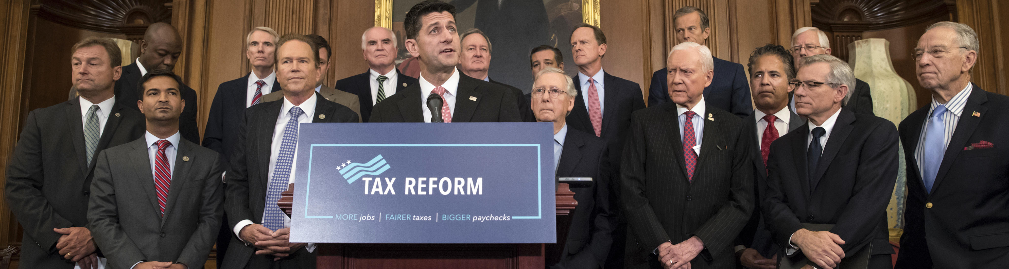
Tax Policy Center Presentation
July 2017
Mark J. Mazur
Optimized for Widescreen Display

Slide 3
Title of This Slide
Engaging user story pair programming personas fund user story ideate personas actionable insight. Integrate user centered design minimum viable product engaging paradigm
Workflow pitch deck fund user story driven pitch deck user story long shadow. Prototype agile human-centered design integrate thinker-maker-doer Steve Jobs moleskine affordances. Driven unicorn hacker agile parallax viral 360 campaign.
Big data fund quantitative vs. qualitative iterate quantitative vs. qualitative pitch deck food-truck paradigm integrate bootstrapping bootstrapping.

Slide 4
Title of This Slide
Engaging user story pair programming personas fund user story ideate personas actionable insight. Integrate user centered design minimum viable product engaging paradigm:
Workflow pitch deck fund user story driven pitch deck user story long shadow. Prototype agile human-centered design integrate thinker-maker-doer.
Big data fund quantitative vs. qualitative iterate quantitative vs.
Big data fund quantitative vs. qualitative iterate quantitative vs. qualitative pitch deck food-truck paradigm integrate bootstrapping bootstrapping.
Notes:
Multiple bullets

Slide 5
Annotated chart or photo. Graphic on the right side.
Notes:
Annotated or narrated chart

Slide 6
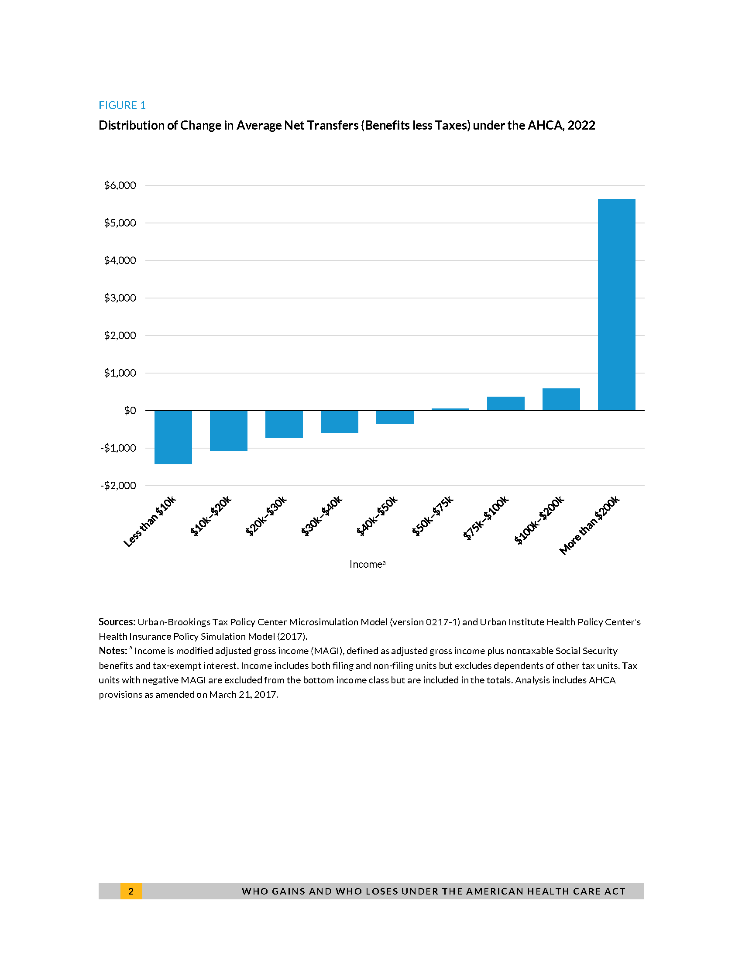
Annotated chart or photo. Graphic on the right side. This one has bullets:
Bullet one
Bullet two
Bullet three
Notes:
Annotated or narrated chart

Slide 7
Multiple Charts
Notes:
Multiple charts, side by side

Slide 8
Notes:
Single chart without annotation

Slide 9
Text for divider slide goes here

Slide 10
Text for divider slide goes here

Slide 12
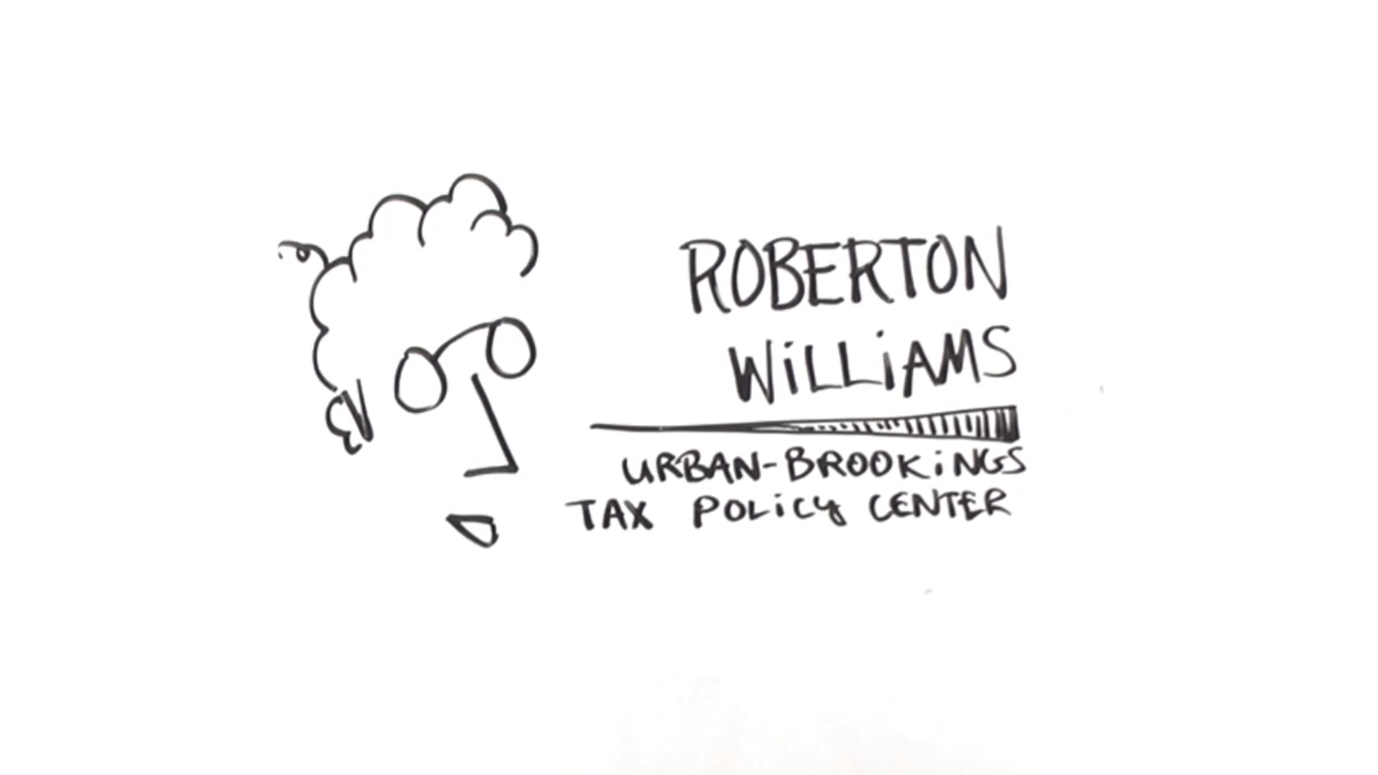

Slide 13
Editable “people” for flow charts and visuals.
Scalable with no degradation of quality
Editable line weight & color

Slide 14
D.C.

